Slide 1
Air Quality forecasting (CO2 emissions)
<Group 5 >
Praphullkumar Bapu Dhumal
Ankush Kailas Pillewar
Mohd Javed Ansari
Mukesh Ramesh Salunke
Nikita Ashok Raut
Snehal Sambhaji Lawande
<Mentor Name>
Mr Adhvaith Sir

Slide 2
Business Problem:
Air Quality forecasting(CO2 emissions) helps a government to follow norms with respect to CO2 emission.
Forecasting the co2 emission by analysing the data of them is useful to understand the co2 emission.
Objective:
To forecast Co2 levels for an organization so that the organization can follow
government norms with respect to Co2 emission levels.

Slide 3
Project Architecture / Project Flow
Data Preparation
Data Cleaning
EDA
Model Building
Model Evaluation
Dataset
Model Deployment

Slide 4
Exploratory Data Analysis (EDA)

Slide 5
Data Set Details
Dataset is in excel format. It contains 215 rows and 2 columns (features).
Missing Values - There are zero null values .
No duplicate rows and columns.
Data type is float 64.
There were no duplicate or negative values found in the provided dataset.
Additional information is :
 | Count | mean | std | min | 25% | 50% | 75% | max
Year | 215 | 1907.0 | 62.209324 | 1800.00 | 1853.50 | 1907.0 | 1960.5 | 2014.0
CO2 | 215 | 6.74197 | 6.52243 | 0.00175 | 0.04105 | 6.39 | 11.5 | 18.2

Slide 6
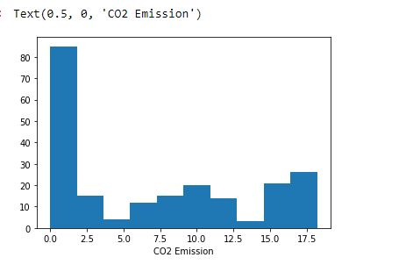
Exploratory Data Analysis (EDA)
Frequency of Co2 emission is high between 0 to 1.
Data is not symmetric

Slide 7
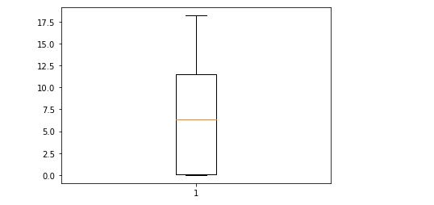
EDA
There are no outliers.

Slide 8
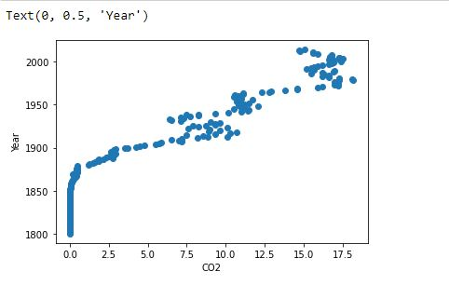
EDA

Slide 9
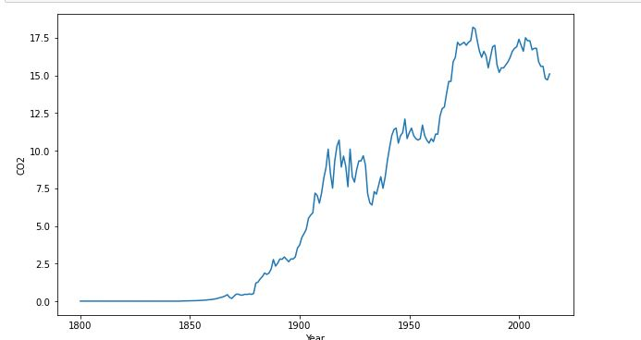
EDA
This is showing increasing trend.
There are some noise points.

Slide 10
Augmented Dickey Fuller Test :
H0: The time series data is not stationary.
H1: The time series data is stationary.
Test Statistics: -0.3784
p - value: 0.9136
Critical Values:
1% : -3.461
5%: -2.875
10% : -2.574
Conclusion : We accept H0. The given time series data is not stationary.

Slide 11
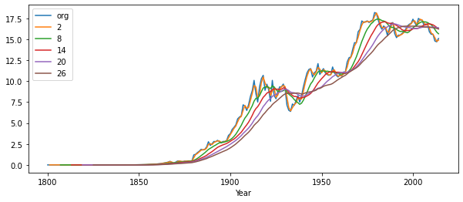
Rolling Moving Average

Slide 12
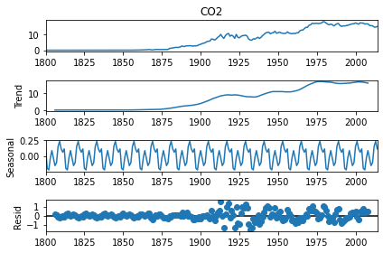
Time series decomposition plot

Slide 13
Model Building

Slide 14
Model building is done on both stationary and non- stationary data.
We have used differencing method to make data stationary.
After doing transformation we have checked with ADF test.
H0: The time series data is not stationary.
H1: The time series data is stationary
Test Statistics: -3.78
p - value: 0.0031
Critical Values:
1% : -3.461
5%: -2.875
10% : -2.574
Conclusion: Test Statistics is less than critical values. We reject Ho here. Our data is stationary.

Slide 15
Data Splitting
We did sequential splitting here.
In stationary data, we took first 200 rows of the data for training and remaining 14 rows of the data for testing.
In non-stationary data, we did follow the same pattern.
i.e. first 200 rows for training and remaining 15 rows for testing.

Slide 16
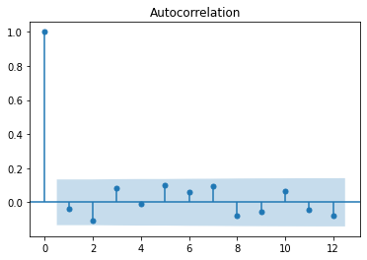
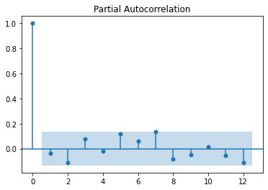
ACF & PACF Plotting For Stationary data

Slide 17
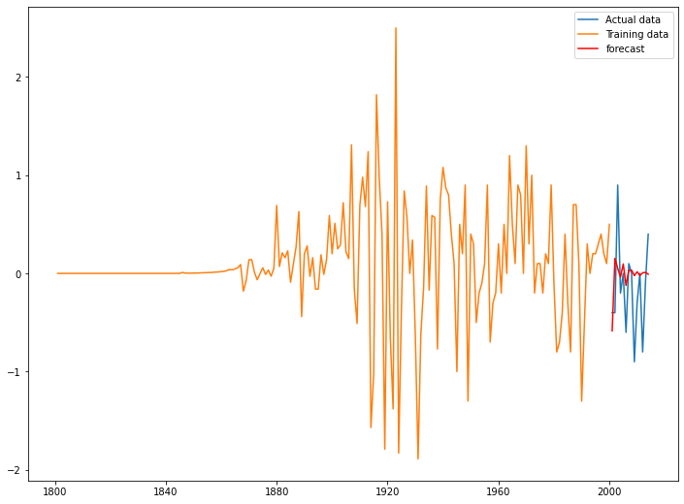
AutoARIMA : (p,d,q) = (4,2,1)
Error: RMSE = 0.4650

Slide 18
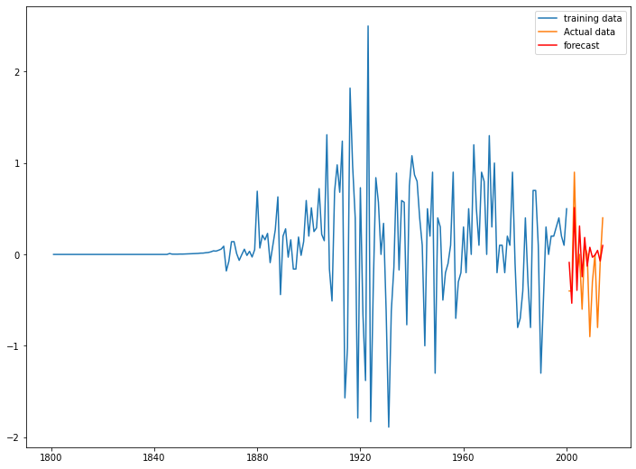
ARIMA Model : (p,d,q) = (5,1,3)
Error: RMSE=0.4126

Slide 19
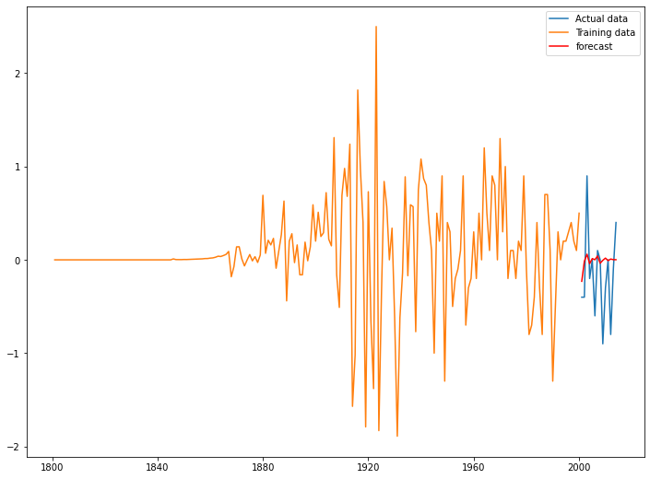
AR Model : (p,d,q) = (7,1,0)
Error: RMSE = 0.4627

Slide 20
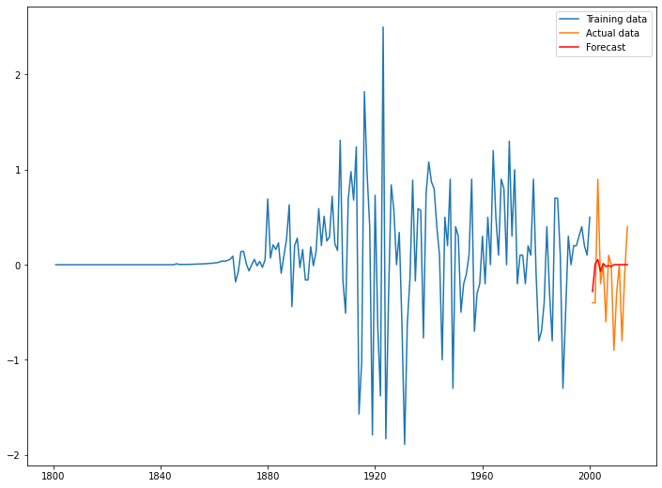
MA Model : (p,d,q) = (0,1,8)
Error: RMSE = 0.4609

Slide 21
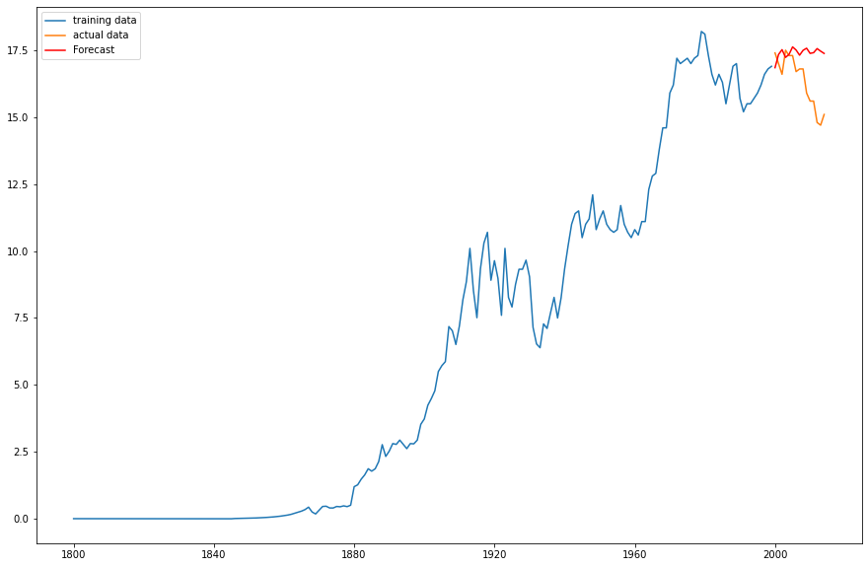
ARIMA Model on non-stationary data: (p,d,q) = (5,0,7)
Error: RMSE = 1.4733

Slide 22
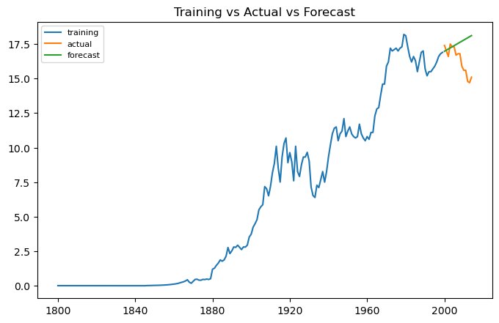
Data Driven Model
Holt Method : (alpha = 0.9, beta = 0.1)
Error: RMSE = 1.7457

Slide 23

Holt Winter Method With Additive Trend
Error : RMSE = 1.7793

Slide 24
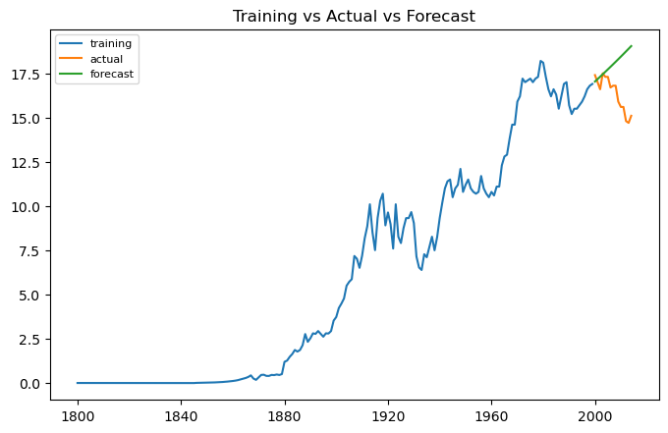
Holt Winter Method With Multiplicative Trend
Error: RMSE = 2.2645

Slide 25
Summary of all Models
Index | Models | RMSE | Normalised RMSE
1 | ARIMA_ns | 1.4733 | 0.0809
2 | ARIMA_SD | 0.4126 | 0.0939
3 | HOLT Method | 1.7457 | 0.0959
4 | Hwe_model (additive) | 1.7793 | 0.0977
5 | MA Model | 0.4609 | 0.1049
6 | AR Model | 0.4627 | 0.1053
7 | AutoARIMA | 0.4650 | 0.1059
8 | HWE_Model(multiplicative) | 2.2645 | 0.1244

Slide 26
Normalised RMSE = RMSE / Max – Min
Original data :
Max Value = 18.20
Min value = 0.001750
Stationary Data :
Max value = 2.500
Min value = - 1.8900

Slide 27
Final Model :
By looking at least normalised RMSE value, we have selected ARIMA(5,0,7) as our final model.
Error of this model is 0.0809

Slide 28
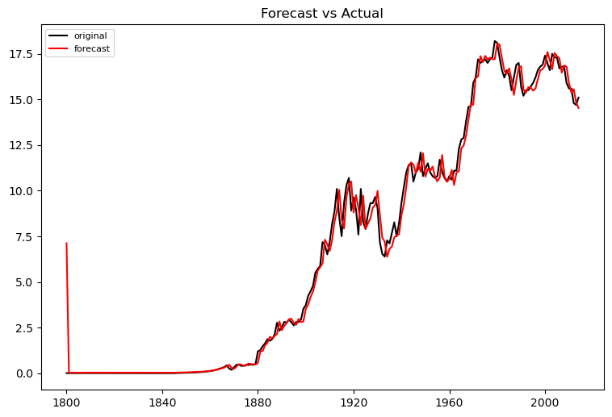

Slide 29
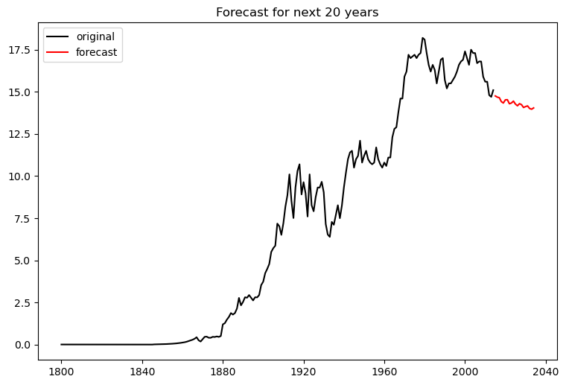
This is the forecast for next 20 years.

Slide 30
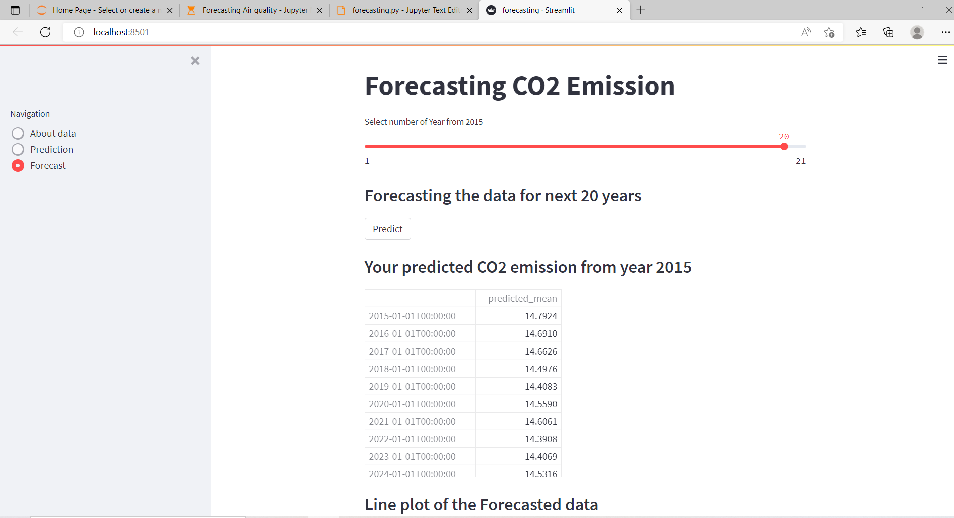
Deployment

Slide 31
Thank you

